Slide 1

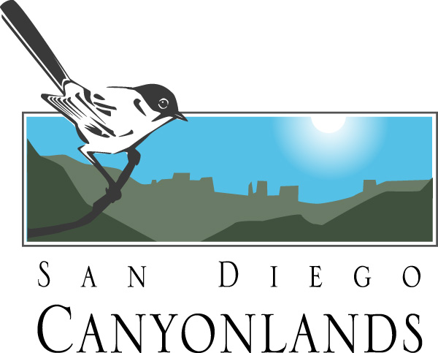
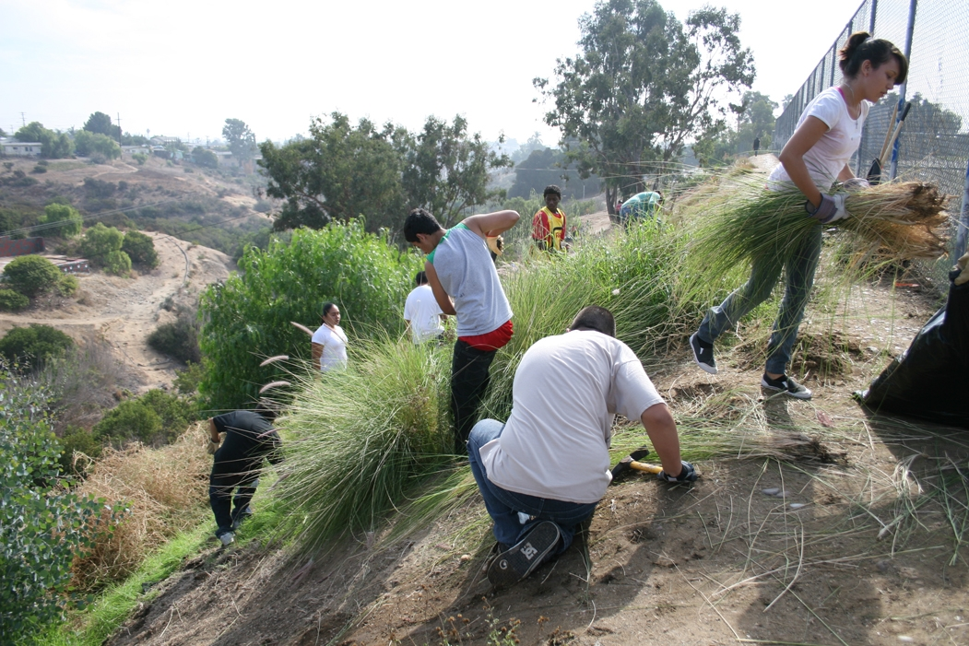
San Diego Canyonlands
MASSIVE
PASSIVE
PARK OPPORTUNITIES
Presentation to:
C-3
Coordinate Century 3
July 24, 2018
Notes:
SDCL Canyon Enhancement Planning (CEP)
The majority of lands proposed for dedication are comprised of canyons and creeks, and SDCL
leadership has been developing volunteer-based community stewardship for these open spaces
for over eleven years. The partnership with these volunteer groups and Open Space Rangers has
proven to be an efficient and effective way to restore and maintain the canyons.
The SDCL Canyon Enhancement Planning (CEP) Committee and program – started in 2009 – is
designed to develop comprehensive plans for each canyon, primarily by providing informative
existing conditions maps and facilitating canyon stakeholder workshops. SDCL has been creating a
CEP Guide that will facilitate a systems approach for integrating our natural open spaces within
the fabric of the urban environment, and will serve as a resource to community and agency
stakeholders to develop enhancement plans for individual canyons, as well as plans to connect
them to improve pedestrian mobility and community access to open space.
Development of this guide is based on a pilot project in Manzanita/Lexington Canyon in City
Heights. SDCL created existing conditions maps and facilitated five stakeholder meetings to
develop an Enhancement Action Plan for that canyon.
SDCL is also working closely with the Open Space Division on the environmental
documentation for a Master Canyon Enhancement Permit to cut cost and red tape for canyon
projects.

Slide 2
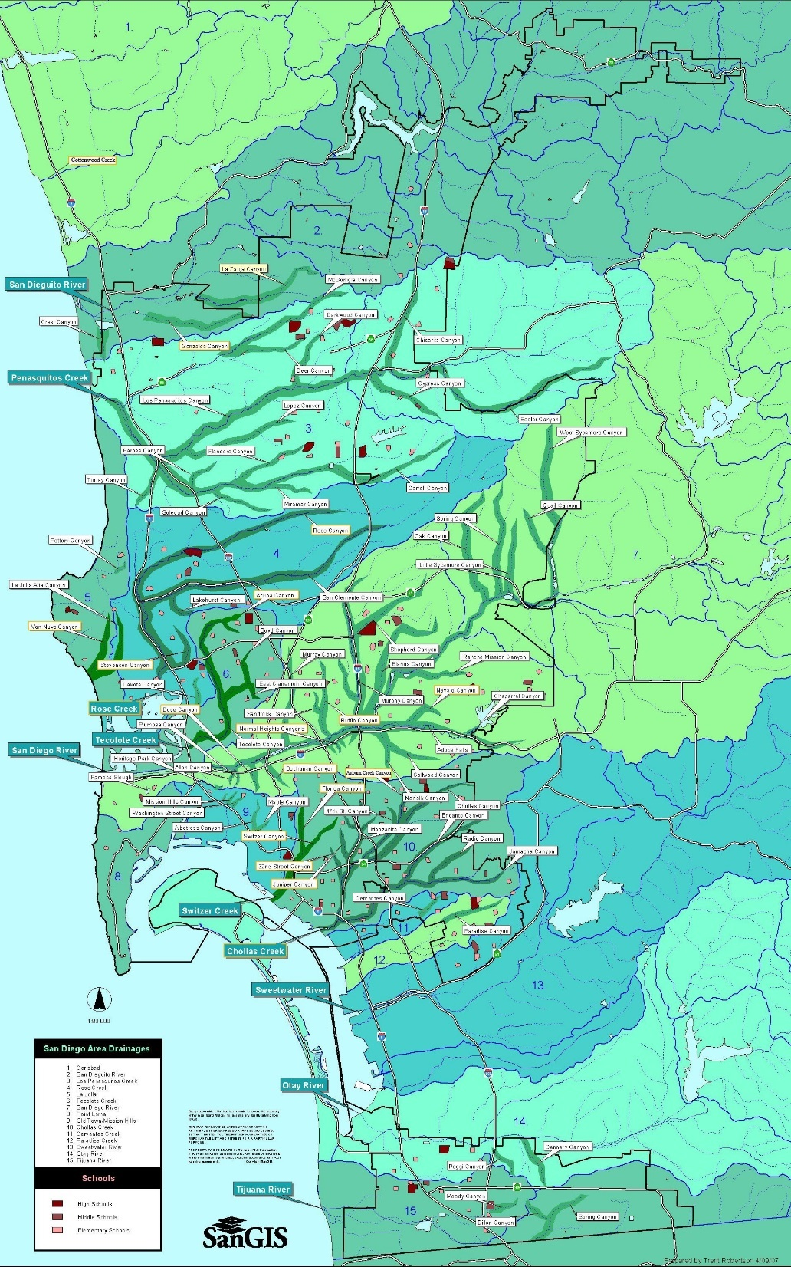
Dozens of
neighborhood
canyons
are distributed
throughout the
City, strategically
located to filter runoff within each urban
watershed.
Fewer Beach Closures
Opportunities for
Urban Nature Trails
Abound

Slide 3
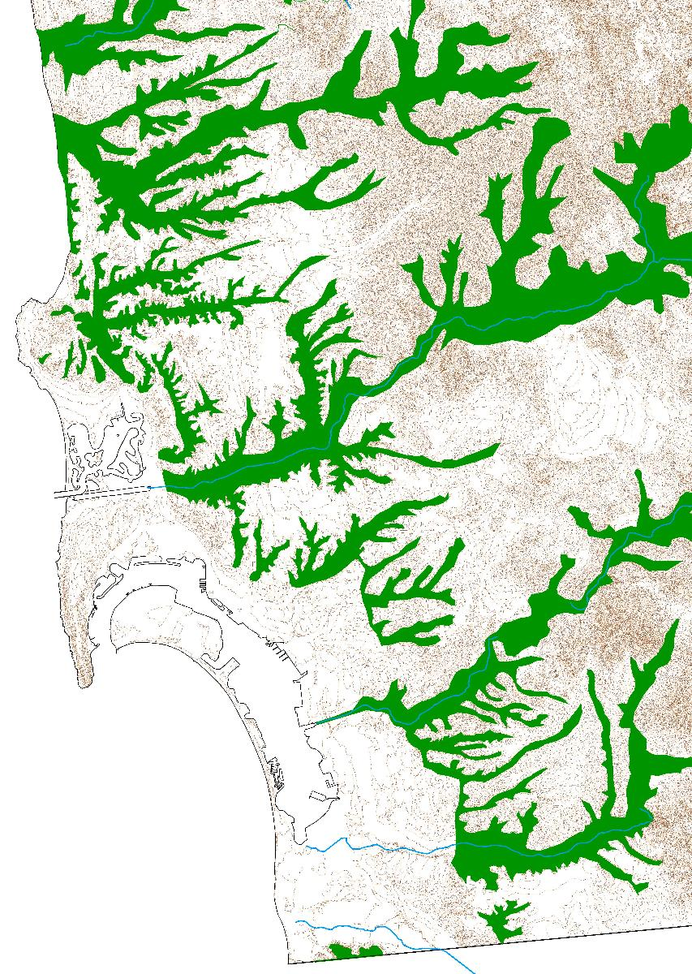
Key Goals
Ecological Goals
Restore watershed natural functions
  Air and Water Filtration
Protect threatened biodiversity
Provide/protect habitat/wildlife corridors
Social Goals
Promote relationship between quality
of life, human health & natural open space
Integrate Nature into the Urban Fabric - LOUV
www.sdcanyonlands.org
Notes:
The CEP goals emphasize . . .
Really, have both evological and social goals . . .

Slide 4
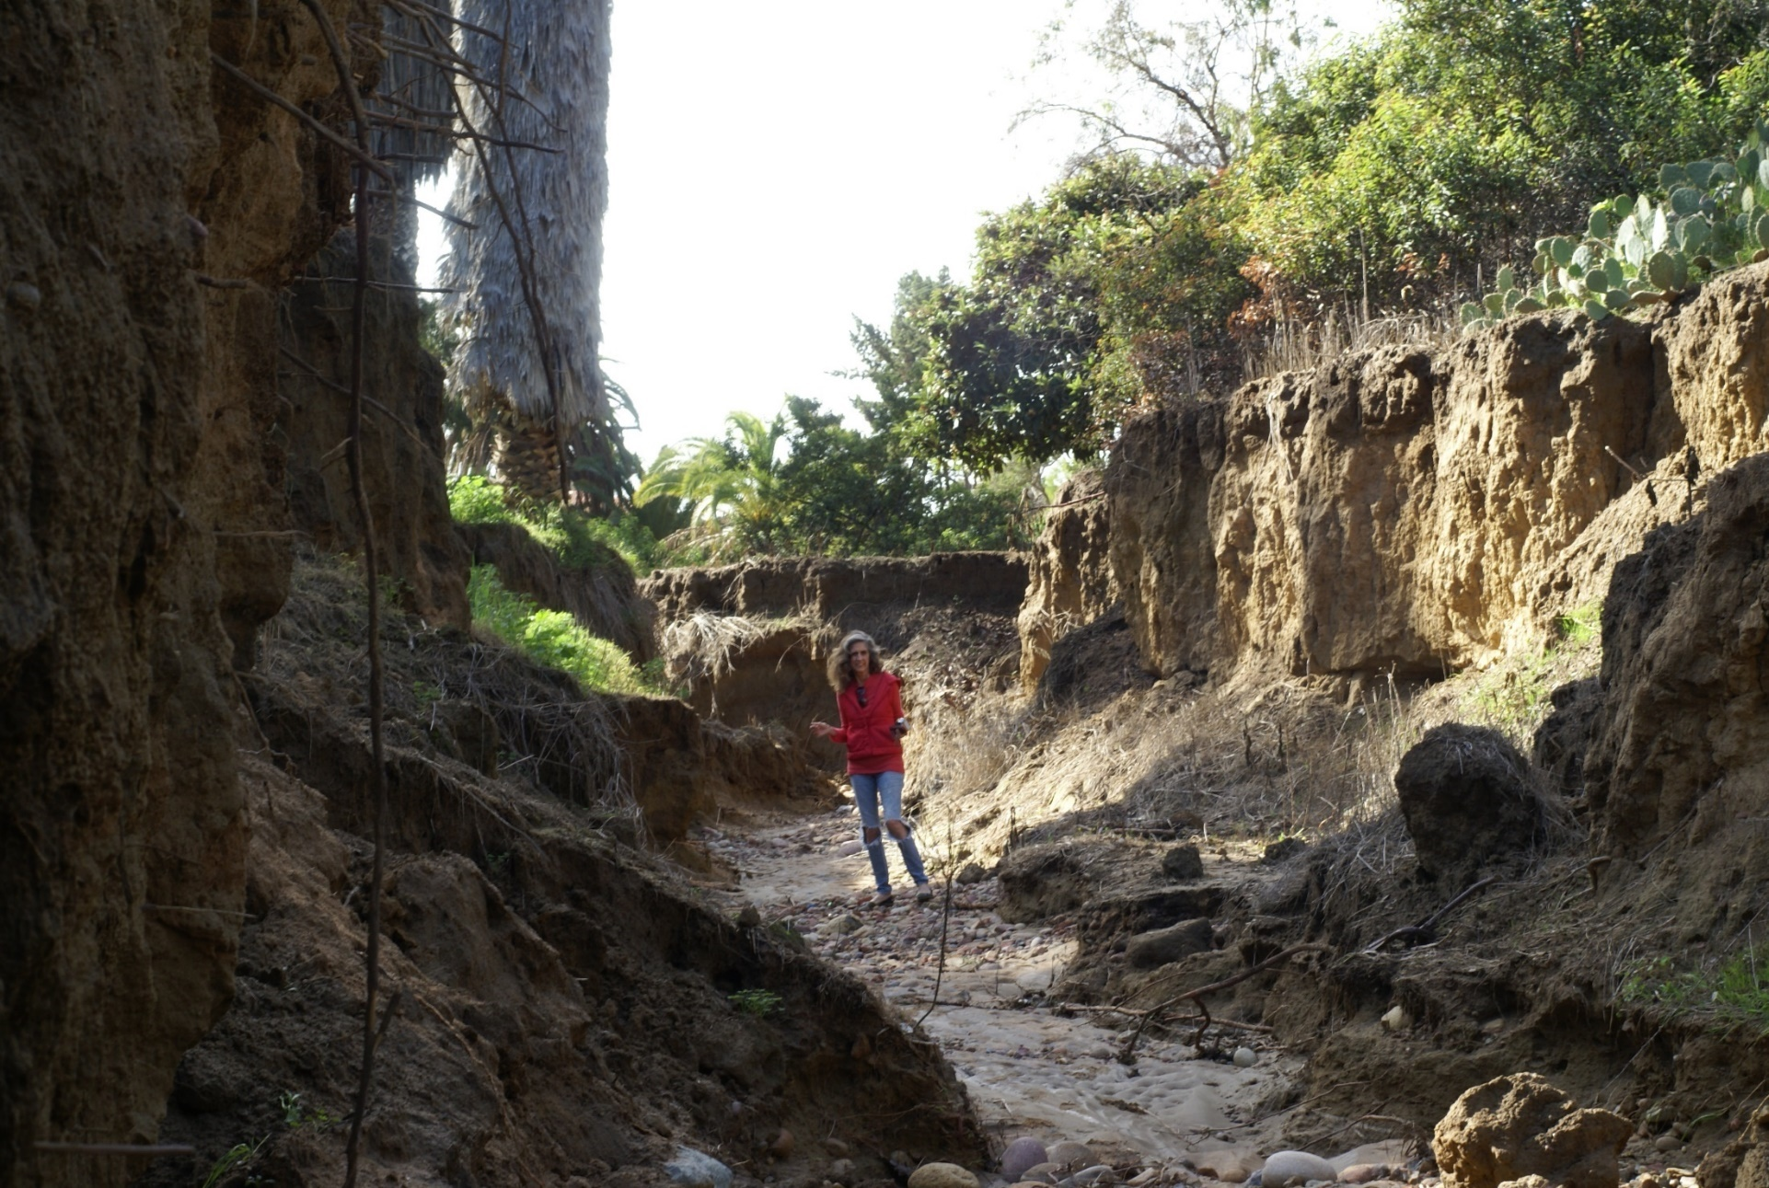
SD Canyonlands & Tershia d’Elgin (leader) creating
Strategy Toolkit to address stream erosion in canyons.
Maple Canyon, Bankers Hill

Slide 5
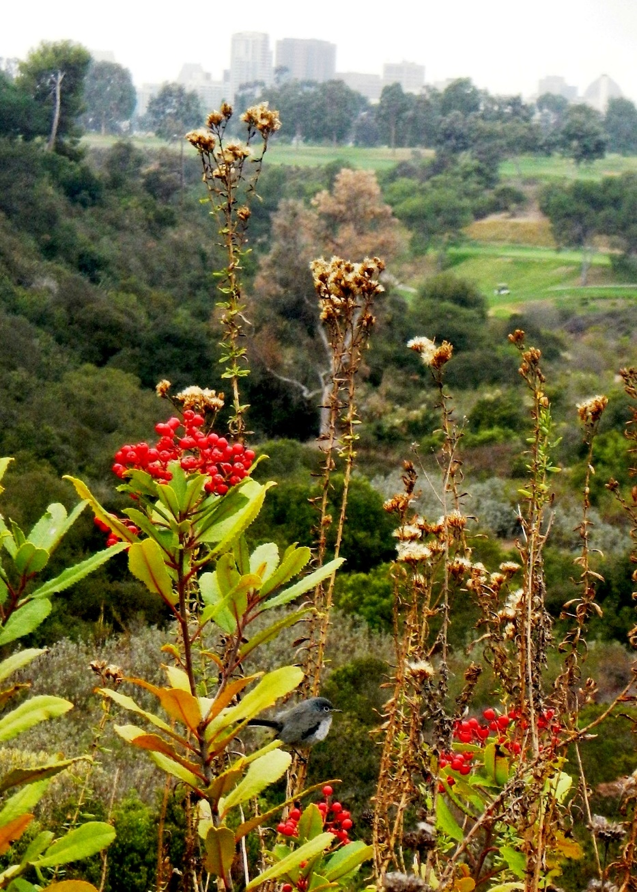
Tremendous Biodiversity in San Diego County
Responsibility to Protect - MSCP
www.sdcanyonlands.org

Slide 6
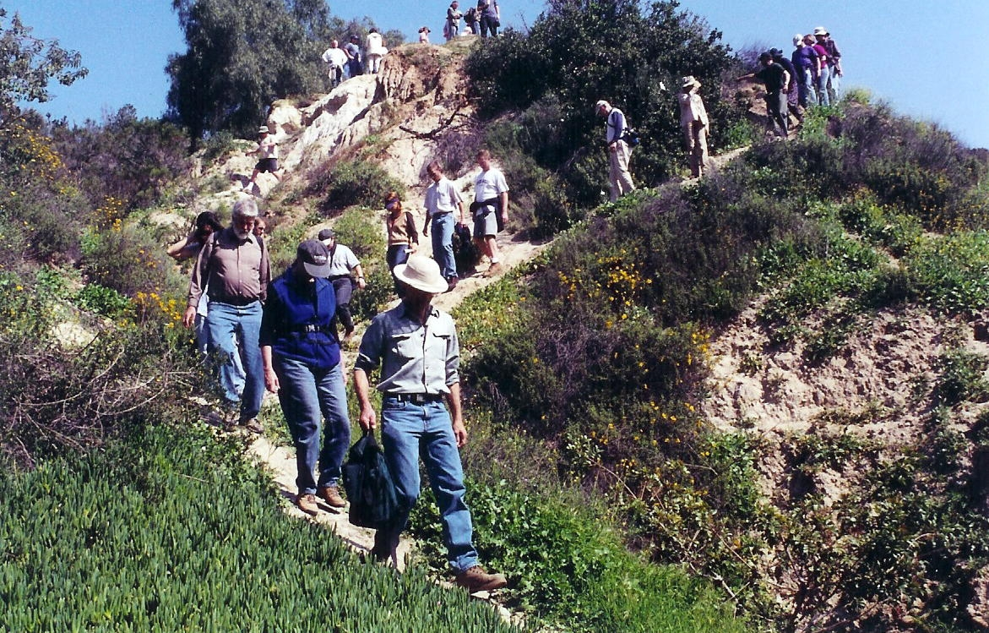
Community Organizing, Canyon by Canyon
Step 1- Build Canyon “Friends” Groups
Eugene Canyon
Normal Heights

Slide 7
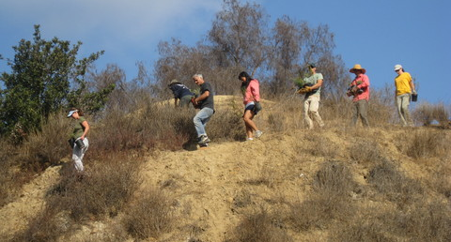
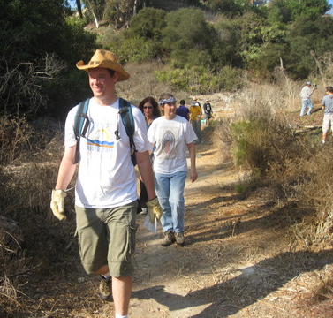
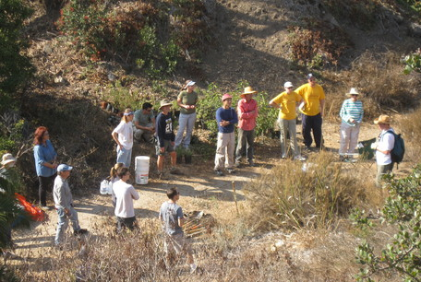
Eugene Canyon
Normal Heights

Slide 8
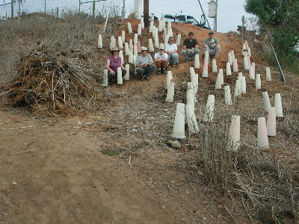
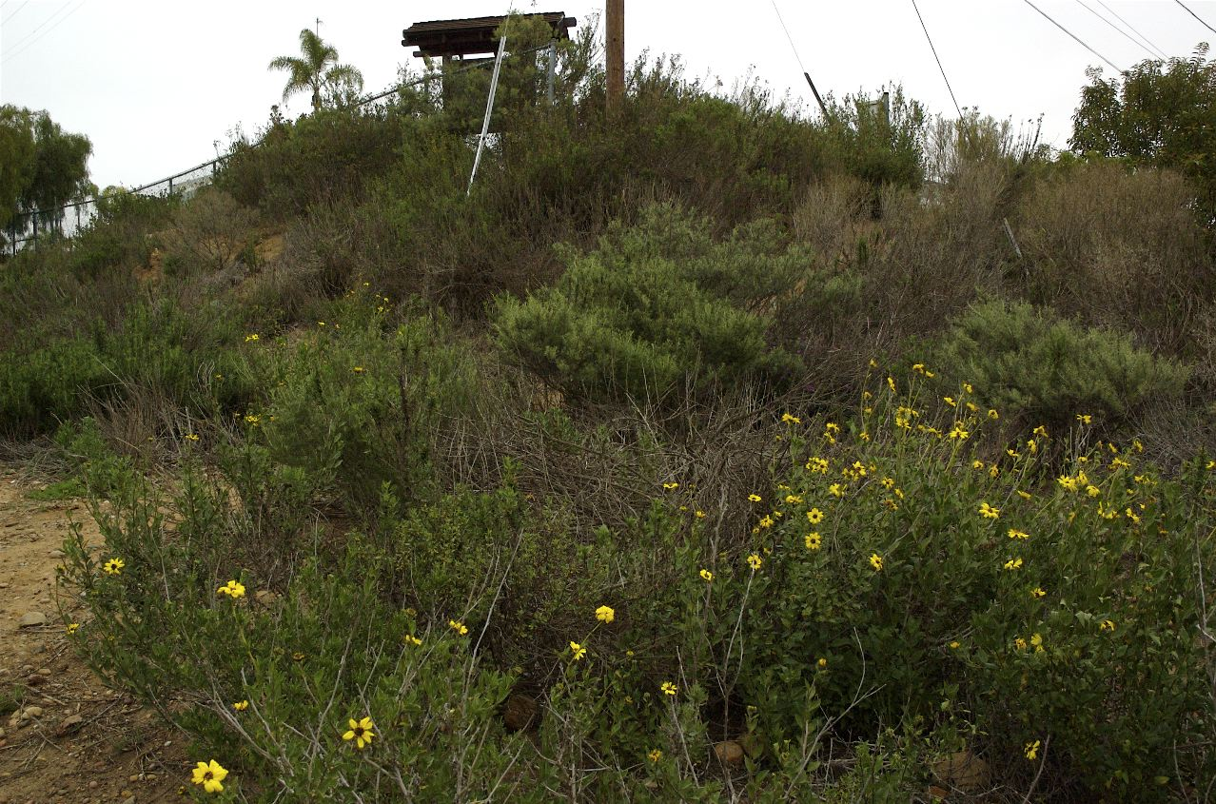
Examples of Improvements
Swan Canyon (Nov 2007)
Swan Canyon (Jan 2009)
Switzer Canyon – BEFORE 2002
Switzer Canyon – AFTER 2012

Slide 9
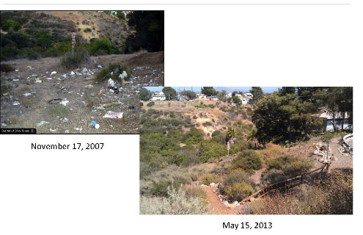
Swan Canyon, City Heights
Before (on left) After (below)
November 17, 2007
May 15, 2013

Slide 10
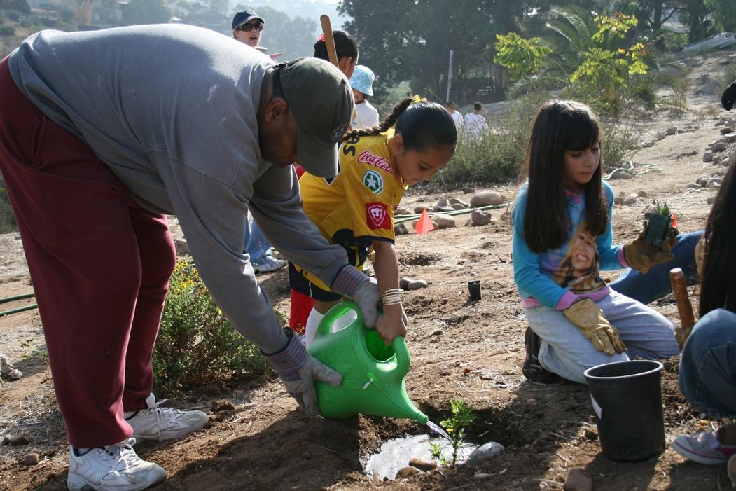
Swan Canyon, City Heights
Elementary school children plant native plants

Slide 11
Swan Canyon, City Heights
Hoover High School Eco-Club clears non-native plants

Slide 12
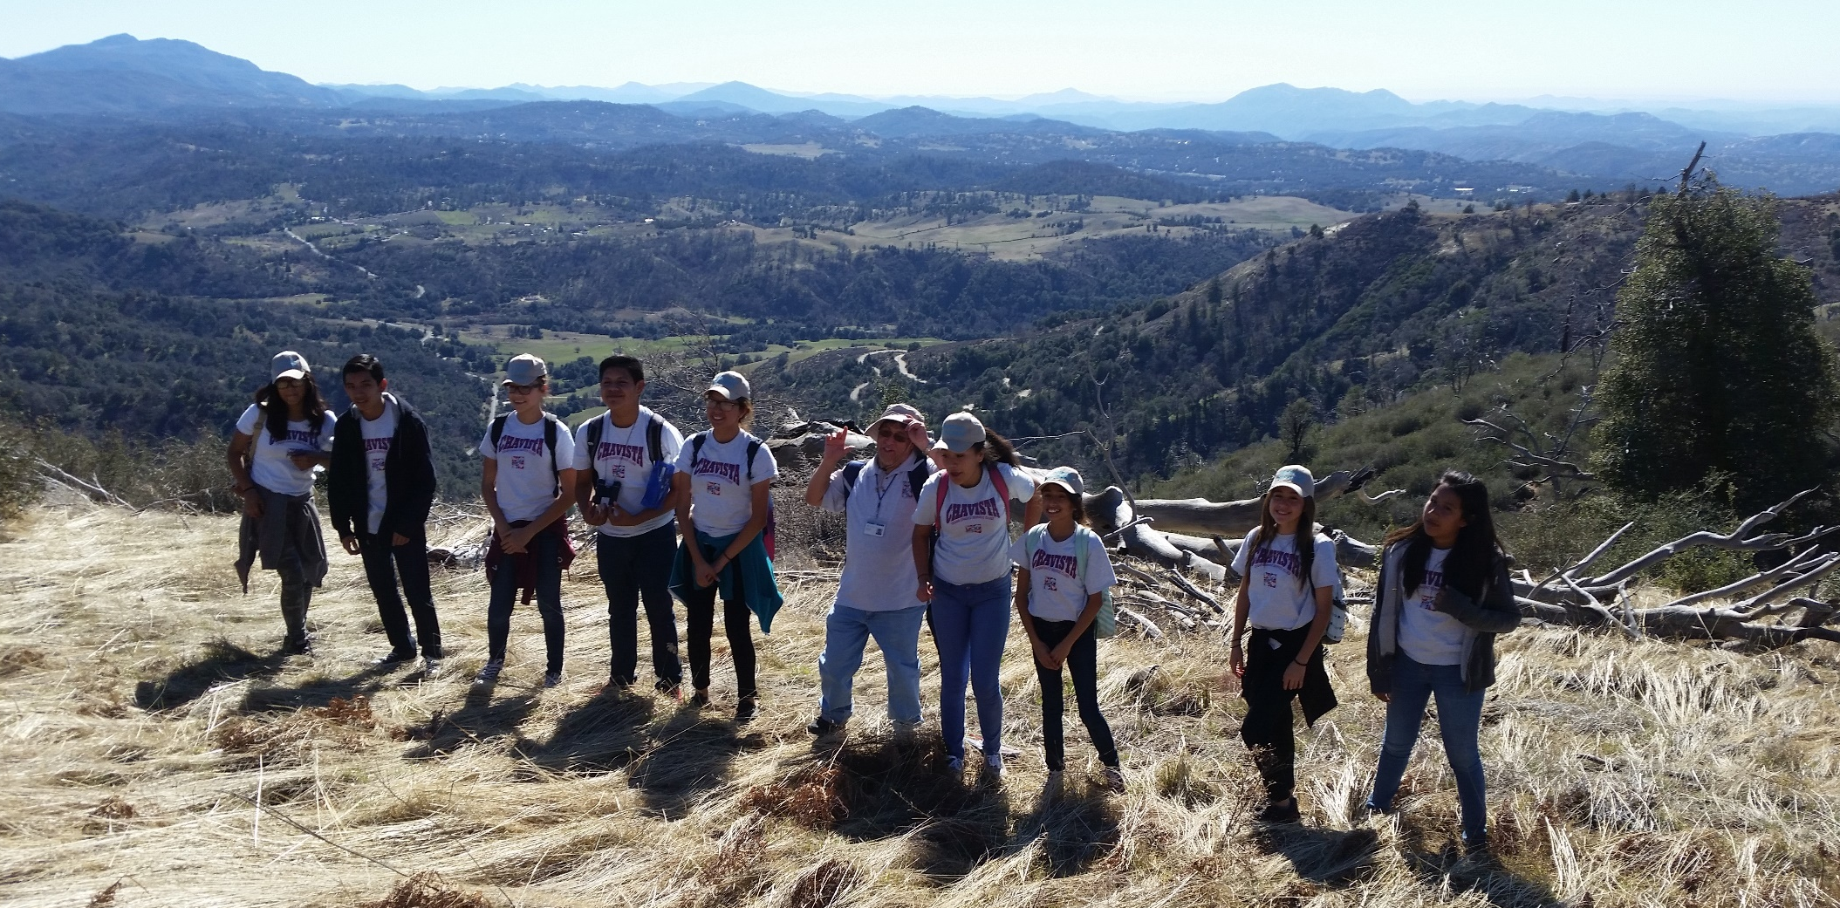
Monroe Clark Middle School City Heights Canyon Volunteers
Treated to San Dieguito River Watershed Tour, Mt. Volcan

Slide 13
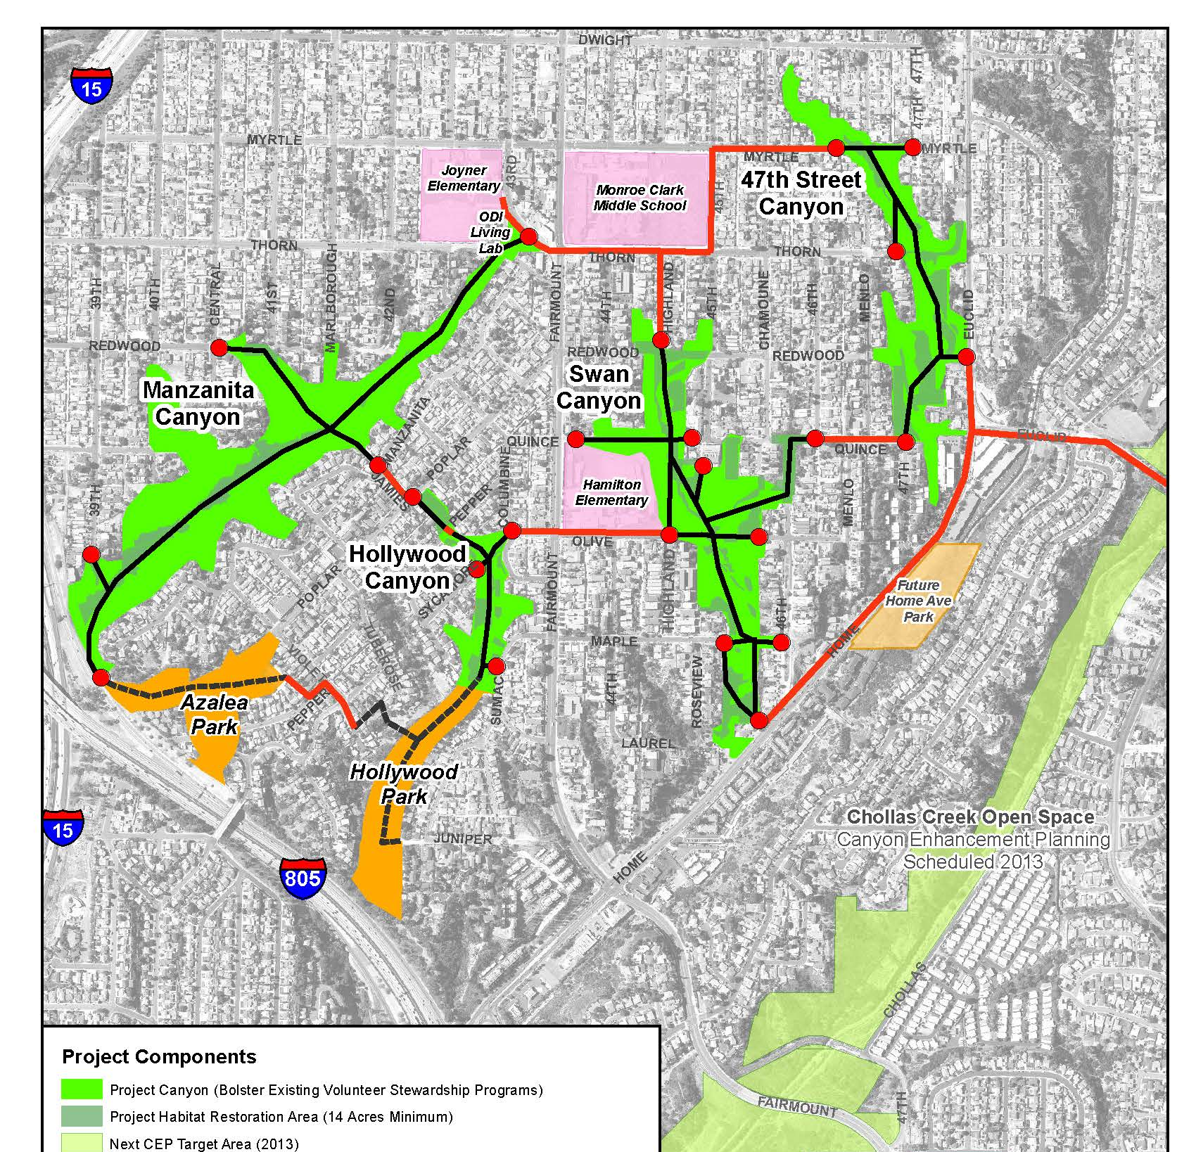

Slide 14
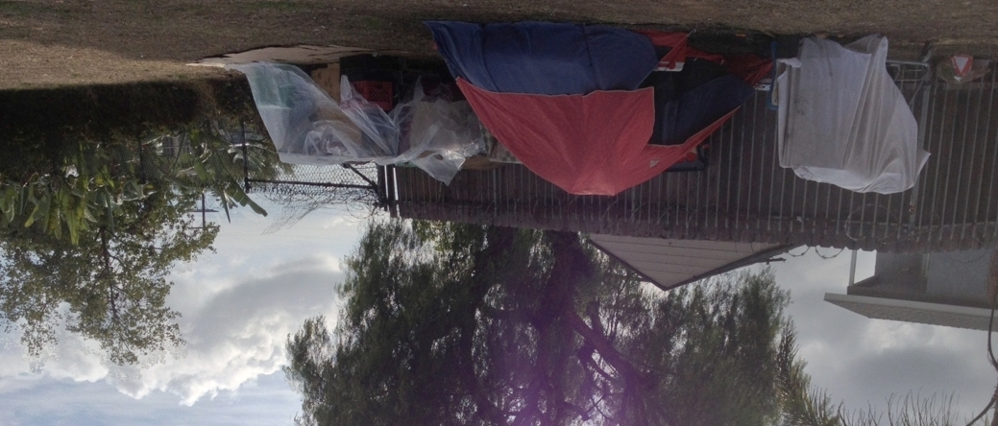
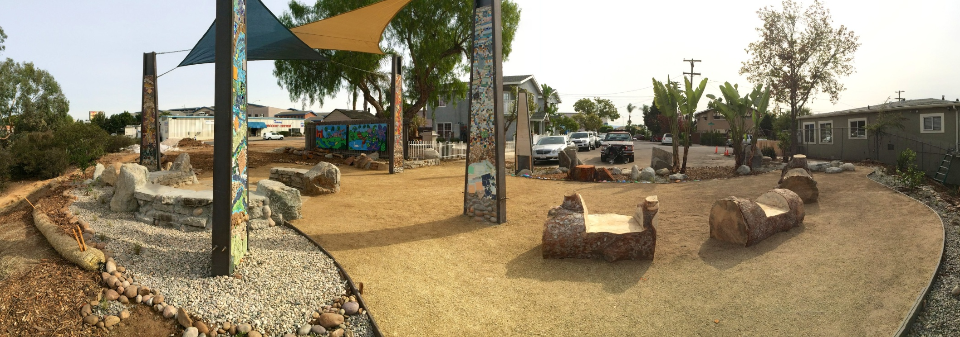
Manzanita Gathering Place 2013
Manzanita Gathering Place 2014
Gateway to the City Heights Canyons Loop Trail

Slide 16
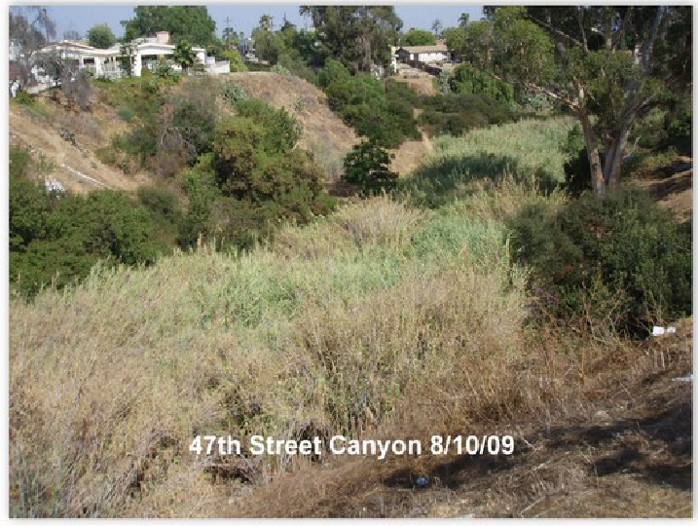
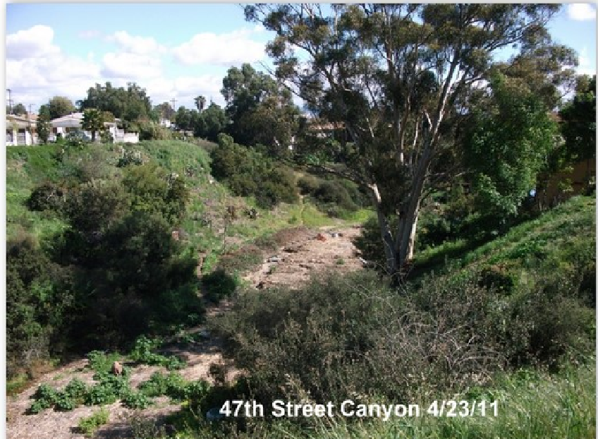
20 months later . . .
Invasive Arundo donax gone

Slide 17
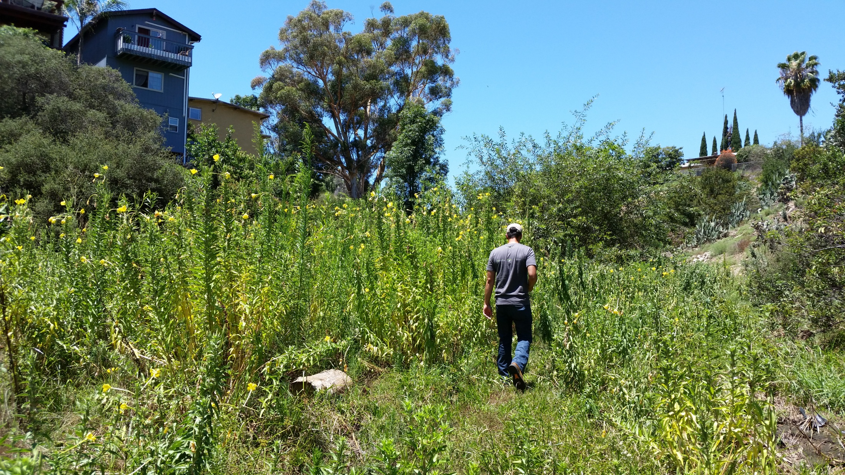
47th St. Canyon, floodplain –Native Evening Primrose in bloom
where Arundo donax once dominated (facing north), (July 24, 2015).

Slide 18
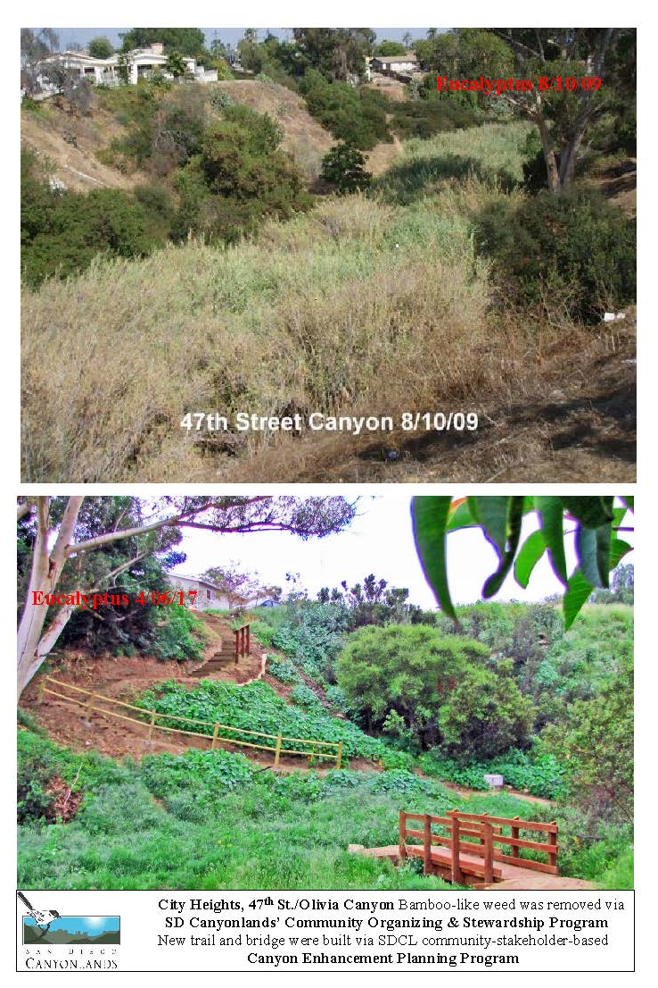

Slide 19
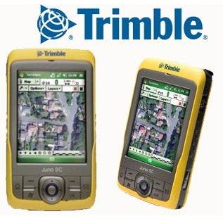


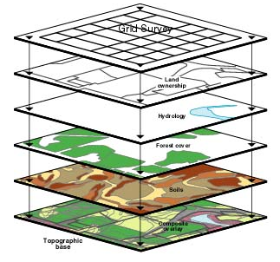
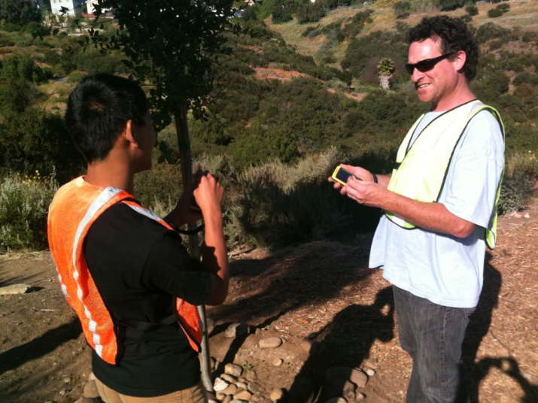
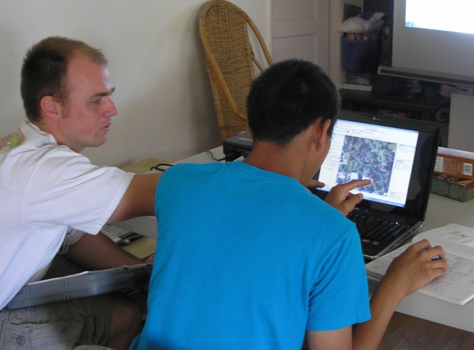
Step 2 - Map Existing Conditions
GIS Mapping Internship Program
Canyon Enhancement Planning Process

Slide 20
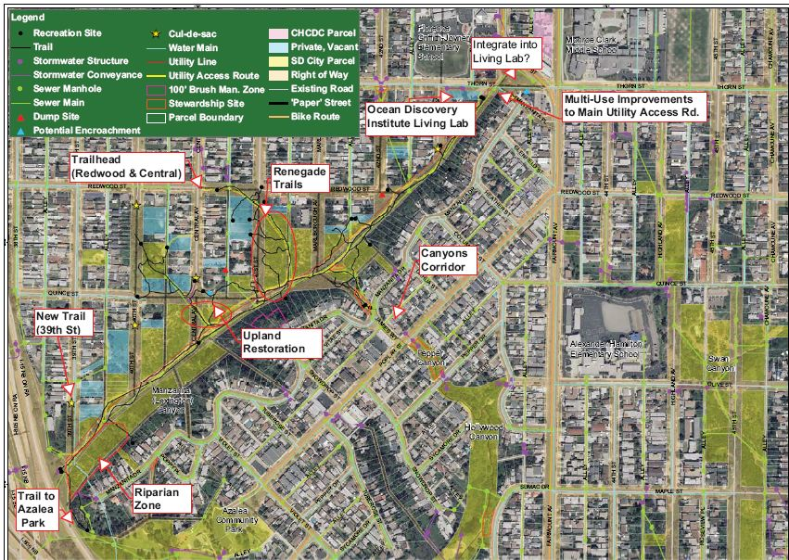
Step 3, Assemble Stakeholders, Create Action Plan
Manzanita Canyon Socio-Infrastructure Map & Action Plan

Slide 21
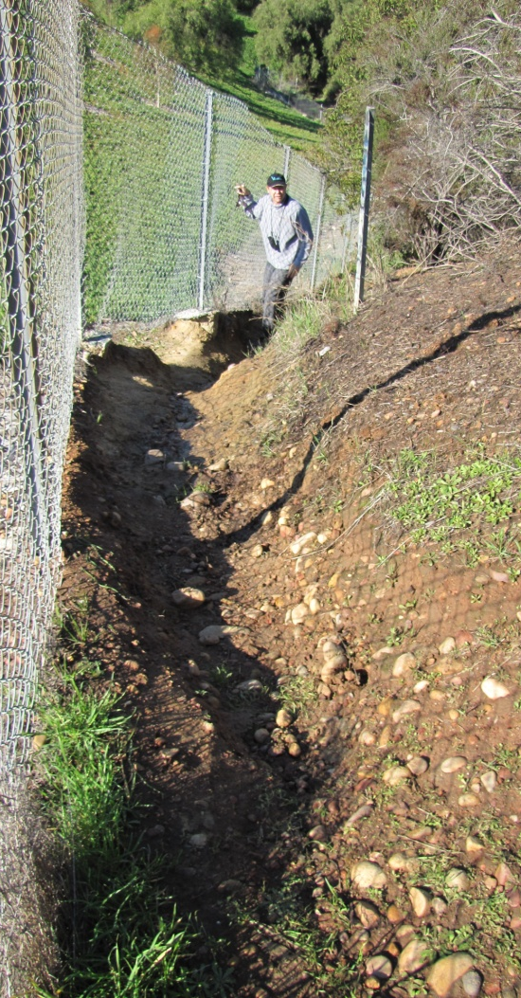
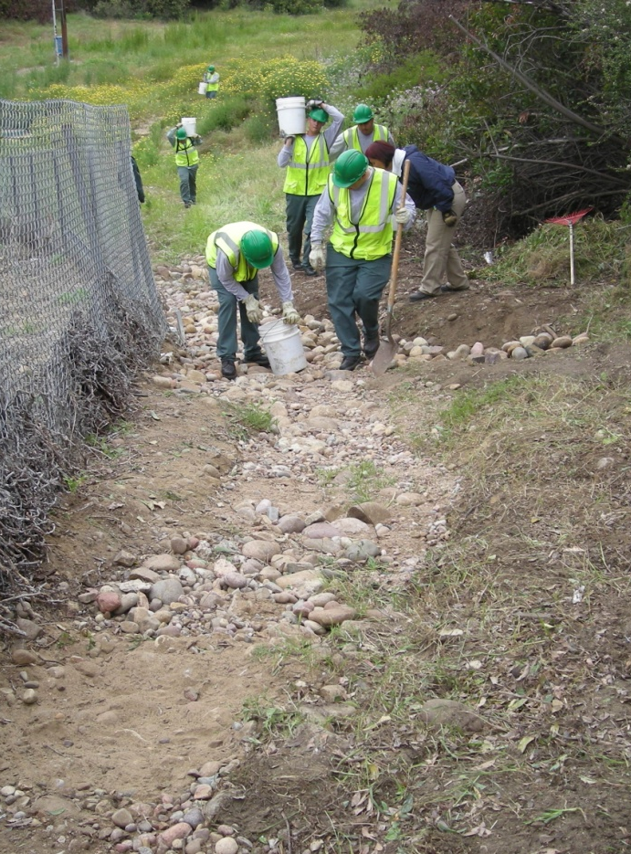
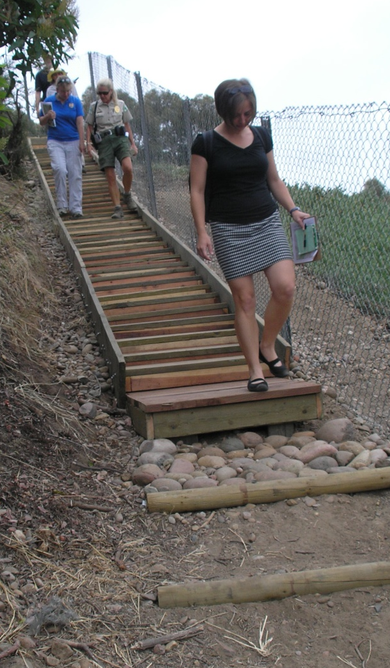
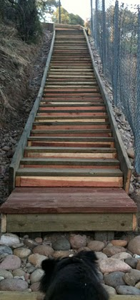
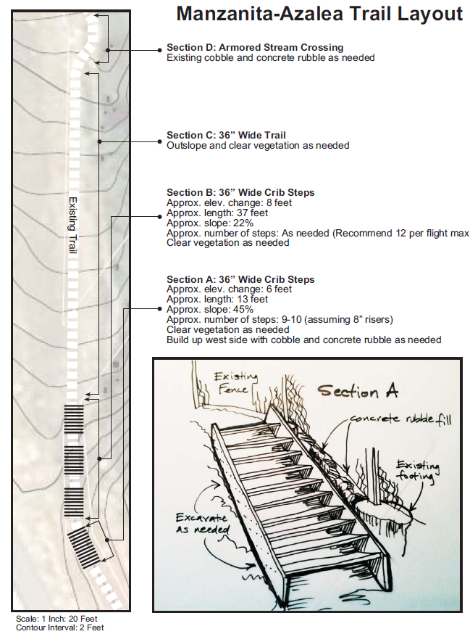
Example – Trail transformation from bottom of Manzanita Canyon to up to Azalea Park
Before
Construction
After

Slide 22
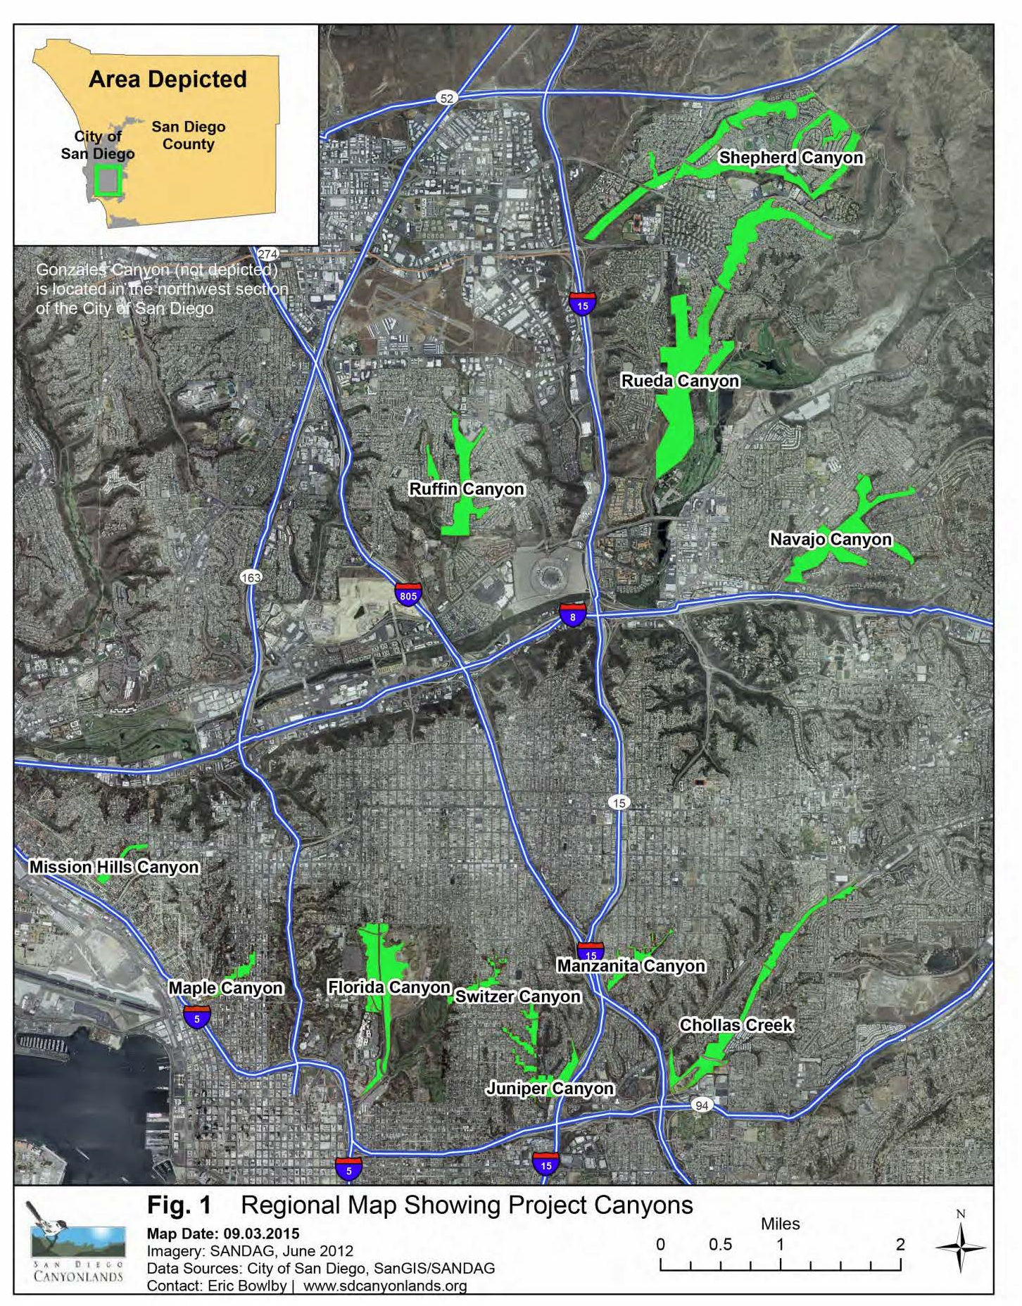
CA Coastal Conservancy
$300,000 Grant for
Canyon Enhancement
Planning 12) Urban Canyons
Water Quality - Bio
Health – Access to Nature
Canyons Nature Classrooms
Hiking -Jogging
#1 Recreational Activity
Open Space Parkland distributed throughout
all San Diego Communities
Low Maintenance
FUNDING
Prop 68 for building trails
Prop 1 for restoration

Slide 23
THANK YOU
C- 3 Support for
San Diego Canyonlands Efforts
Canyon Enhancement Planning
Program CEQA &Master Permit
For Canyon Enhancements
Trails & Restoration
Master Right of Entry
Eroded Stream Restoration
Build a sustainable Non-Profit
for
Sustainable Stewardship
Matching Grant Opportunity

